Slide 1
Cloudant Geomap Example explained
Sebastian Moehn – Cloudant Technical Sales DACH

Slide 2






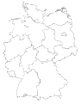



The complete telematics solution
Streams
BigInsights
Gateway
Real-time Analytics
Data storage
Evaluation
Scoring & Pricing
70
$
Geo Fencing
Feedback
& Warnings
!
Archive
Onboard Unit
Time
Speed
Location
Distance
Steering
Breaks
Acceleration
…
Reporting
Predective Analytics
Notes:
In context of a bigger telematics solution, data is send from many cars to a gateway which is connected to IBM InfoSphere Streams. Streams is able to to realtime analytics and filter data. All data is written to IBM BigInsights to do further analytics, but part of the data (speed, location) is sent to Cloudant for realtime access in a frontend. In case of an accident InfoSphere Streams can sent additional data to Cloudants semi-structured data store (e.g. “Airbag deployed”, “Emergency Break”, …) and also send an event (SMS, Push, …) to the car holder, manufacturer or leasing company. This person can then inspect the event in realtime in the frontend based on Cloudant to see more details.

Slide 3
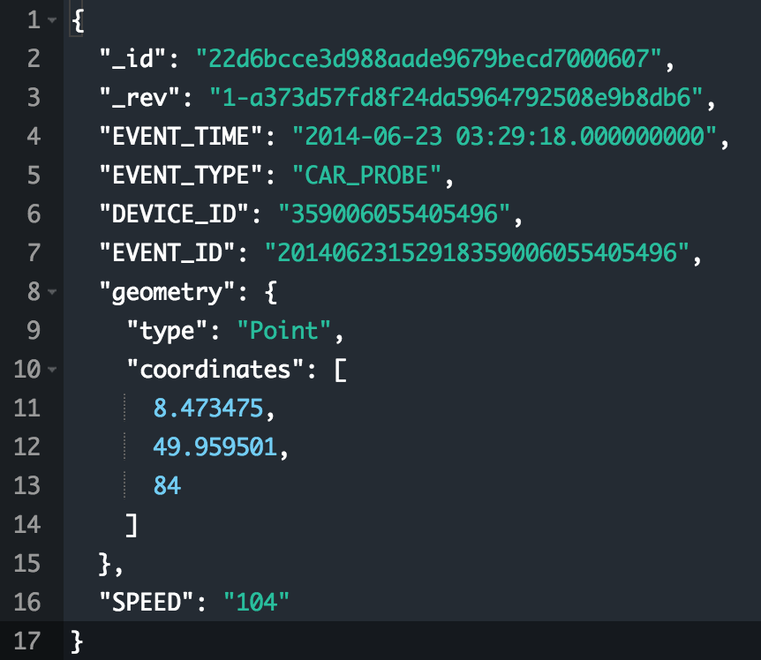
How does the data look in Cloudant?
Only necessary data is saved in Cloudant to reduce general file size
GeoSpatial data is saved as GeoJSON standard by OGC
Speed and Event type is the only additional information needed

Slide 4
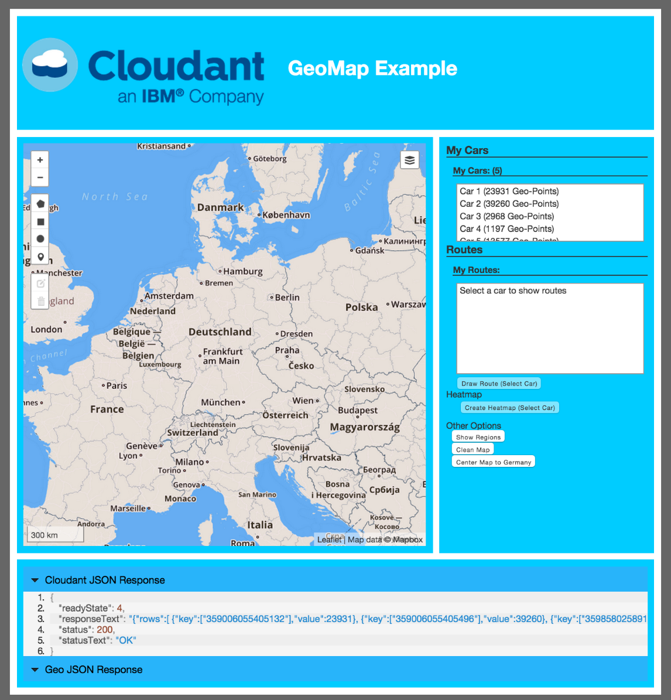
Overview Geomap demo
Used tools:
HTML5, JQuery
Leaflet Map (+ Leaflet Draw)
Benefits by Cloudant:
Complex Geospatial queries
Native use of GeoJSON in Leaflet
Storing unstructured data

Slide 5
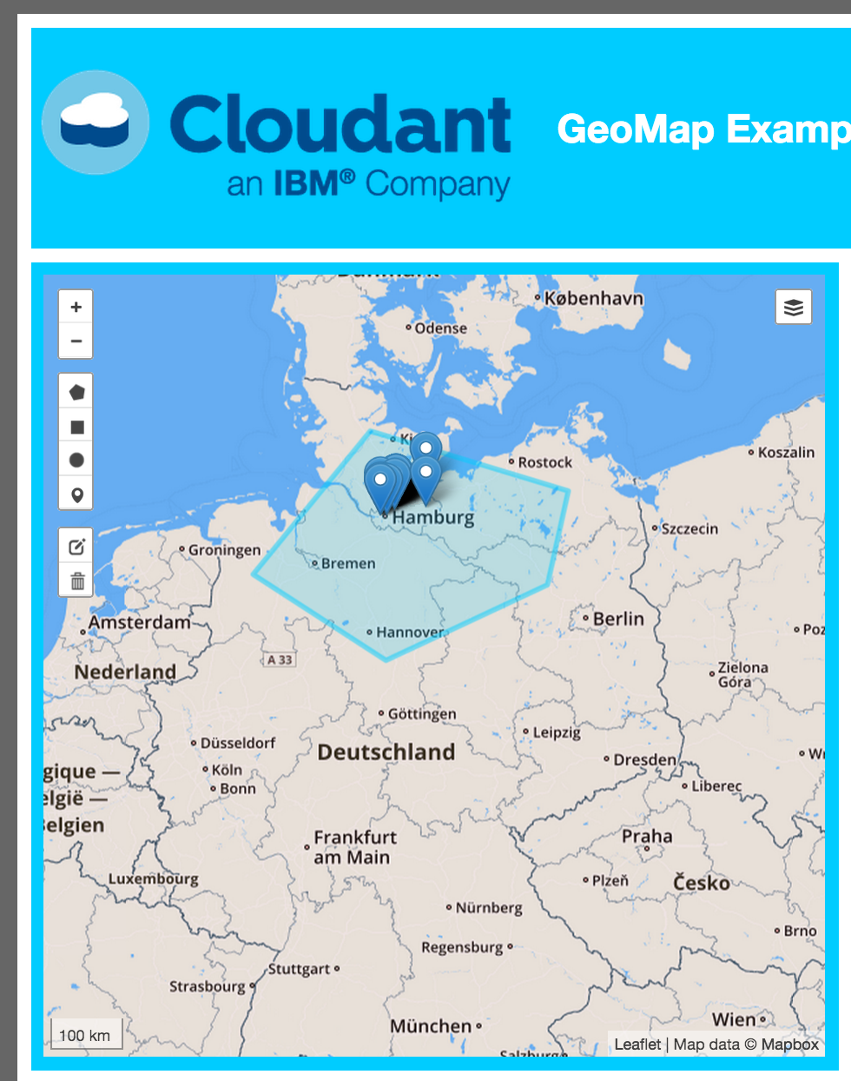
Geospatial queries
Query Routes by any Geospatial Query:
Simple Bounding Boxes
To highly complex polygons

Slide 6
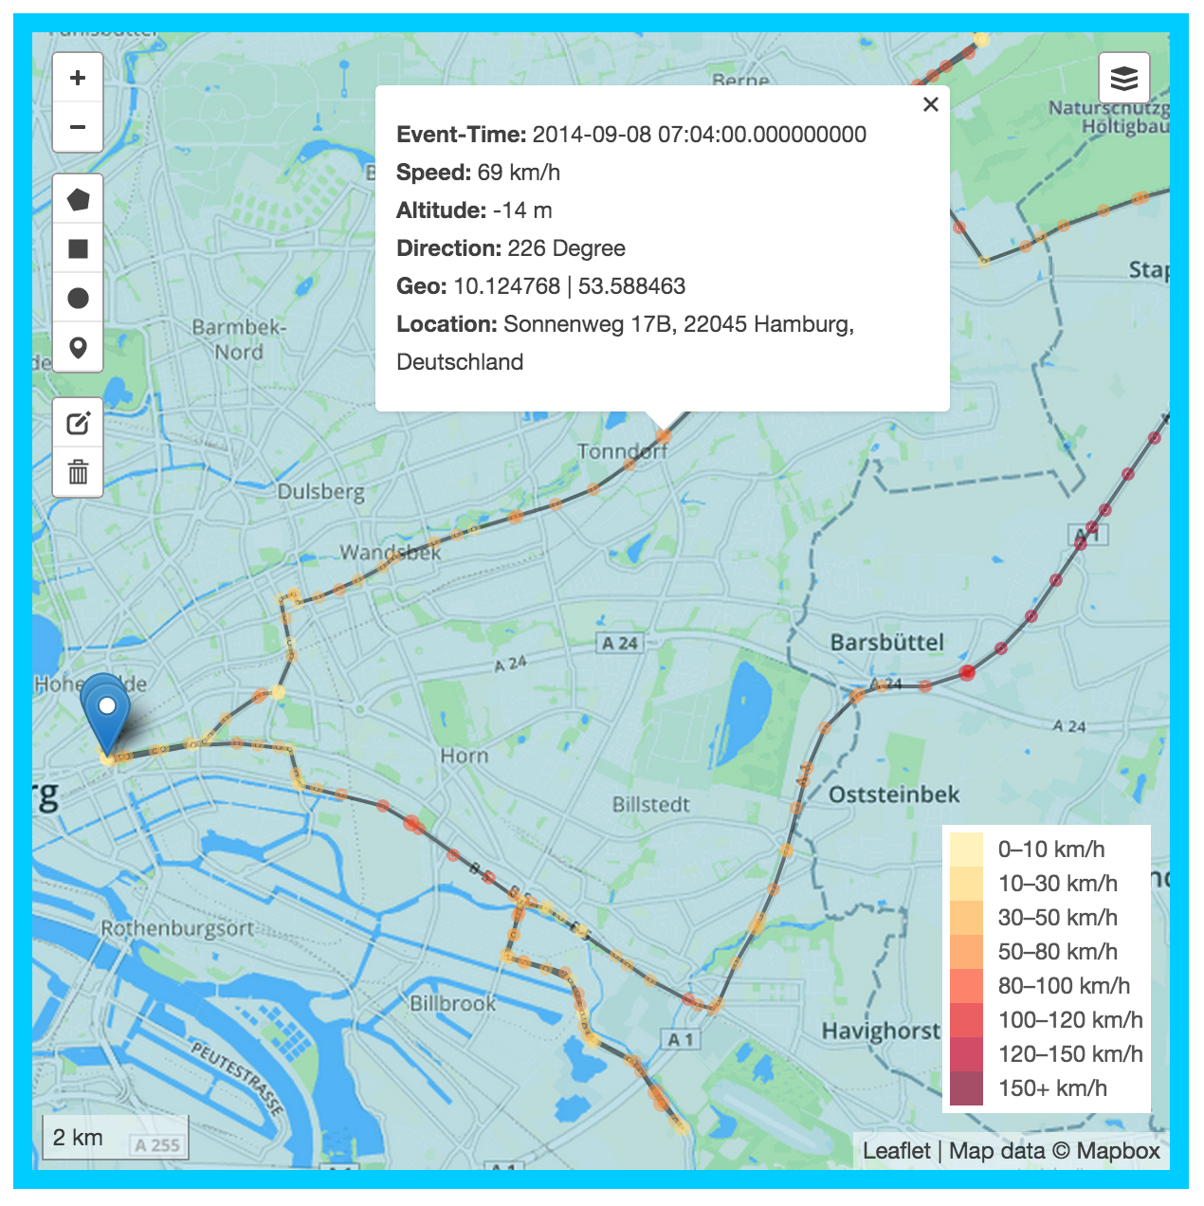
Geospatial queries
Query the Route by pressing the position marker (or by choosing it in the dropdown)
GeoJSON gets queried and automatically displayed by Leaflet Maps
Display additional Information for each Geo-Location by querying Cloudant or a slower data store which stores all data

Slide 7
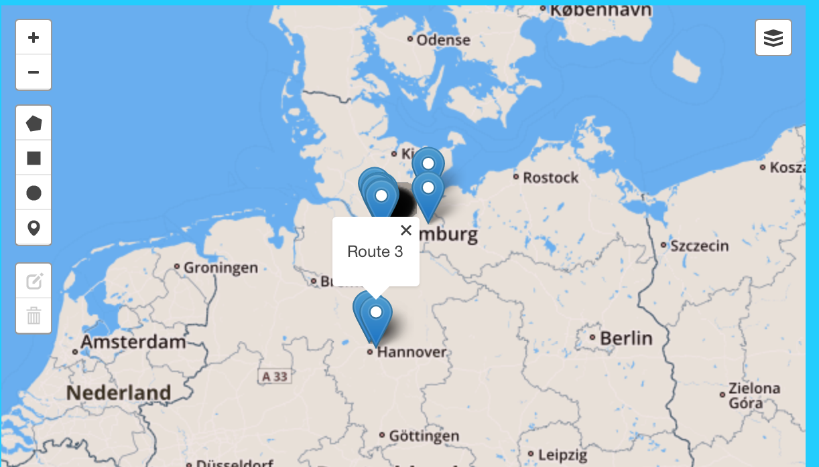
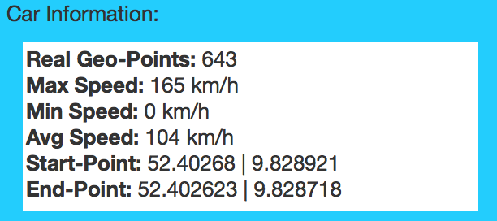
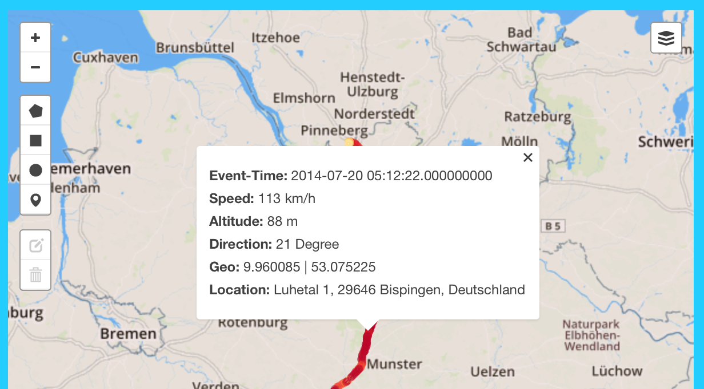
Detailed information

Slide 8
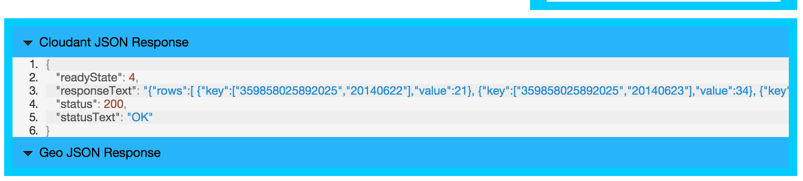
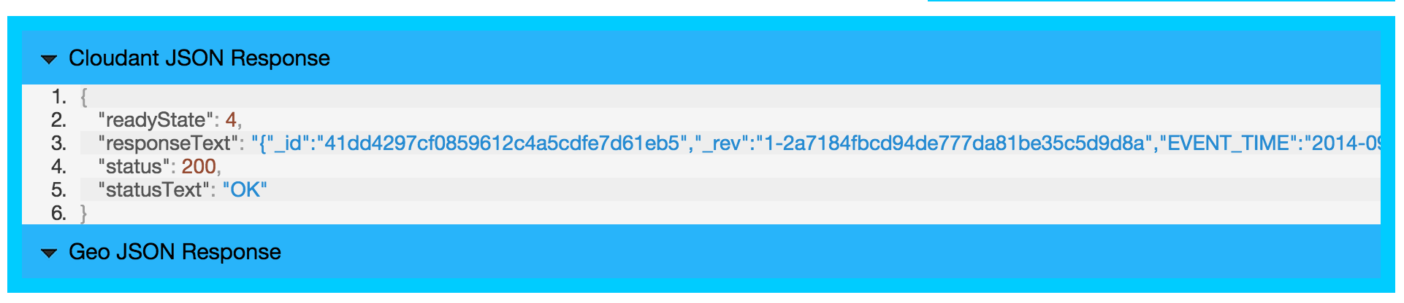
Geomap demo
See your Cloudant JSON responses and GeoJSON responses in a dropdown below the map the learn how to work with different response types

